Slide 1
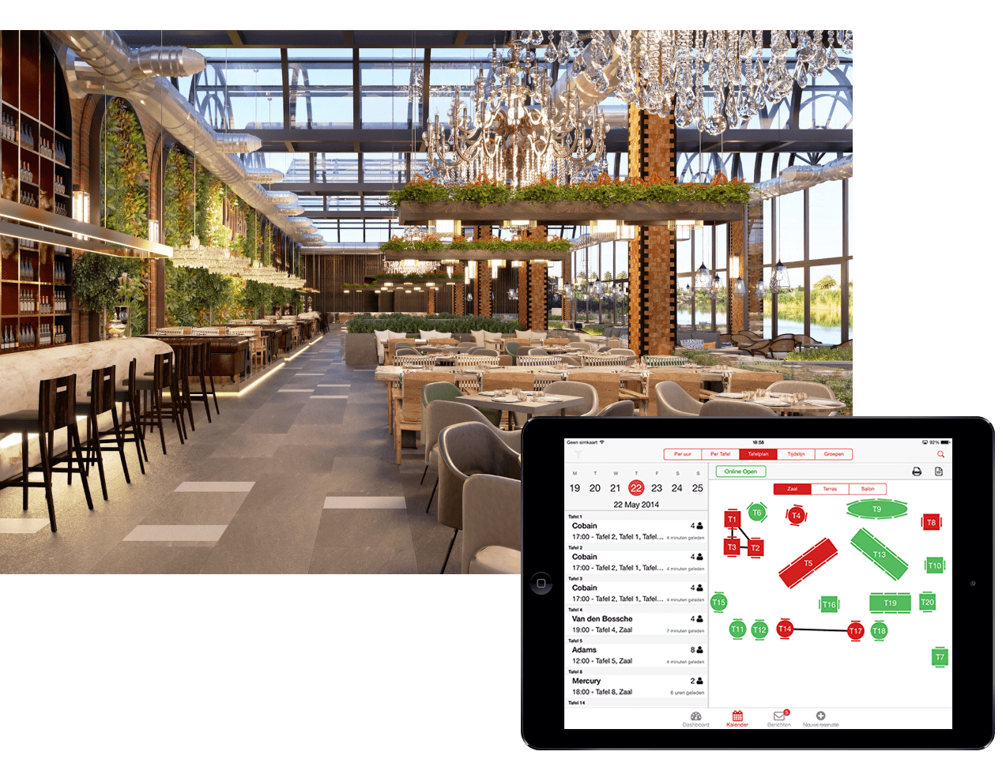
Project Overview: Assignment 1 – Requirements Engineering.
Group members:
1.Justin Angelo Karoles - 222008237
2.Raees Johaadien - 230558135
3.Anwill Jacobs - 219423202
4.Aristide Izabkora - 220345821
5.Ethan Hector - 222816570

Slide 2

Project Purpose: Automating Restaurant Operations
Enhance Operational Efficiency
Streamline daily processes to save time and resources.
Reduce bottlenecks in order processing and service delivery.
Minimize Manual Errors
Implement automated systems to decrease human error in order taking and inventory management.
Improve accuracy in billing and customer transactions.
Real-Time Information Access
Provide instant updates on order status, staff activities, and customer preferences.
Enable data-driven decision-making for management and staff.
Improve Customer Experience
Speed up service delivery and enhance order accuracy.
Foster customer loyalty through personalized service based on data insights.
Support Staff Efficiency
Automate routine tasks, allowing staff to focus on customer interaction and service quality.
Facilitate better communication among team members through integrated systems.
Data-Driven Insights
Collect and analyze customer data to identify trends and preferences.
Use insights to optimize menu offerings and marketing strategies.
222008237 Justin Karoles

Slide 3
Scope
Table management with digital floor plans and real-time status updates.
Order management with digital menu displays and electronic order transmission.
Kitchen management for order tracking and communication.
User management with role-based access and secure logins.
Centralized database with backup and recovery mechanisms.
Out of Scope:
Online ordering and delivery.
Inventory management.
Customer relationship management (CRM).
Payment processing.
Payroll and HR functions.
Mobile apps for customers.
Integration with external systems.
Advanced analytics/forecasting.
220345821 – Aristide Izabkora

Slide 4
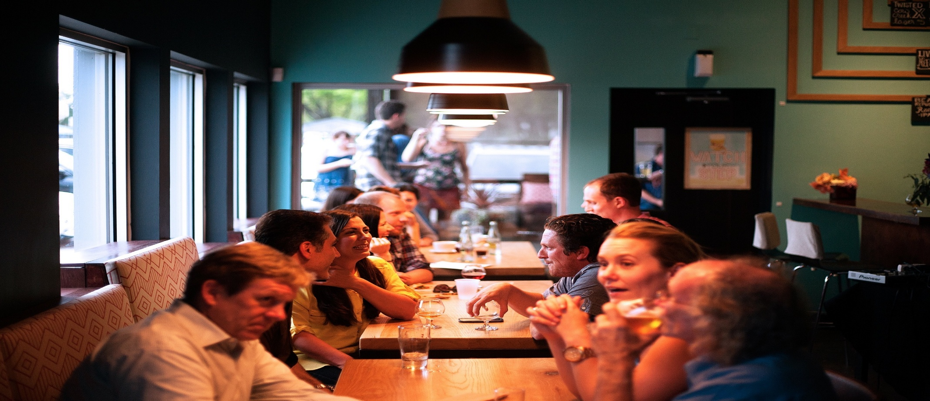
Stakeholders
Restaurant Management: Oversee operations and ensure project alignment with business goals.
Staff (Hosts, Waiters, Kitchen Staff): End-users who will interact with the system daily.
IT Team: Responsible for system implementation, maintenance, and support.
Customers: Indirectly affected by improved service efficiency.
230558135 Raees Johaadien

Slide 5
User and System Requirements
User Requirements
User Requirement 1: Real-time Table Management Staff can view and manage table statuses dynamically.
User Requirement 2: Order Management System Staff can take and transmit orders electronically to the kitchen.
System Requirements
For User Requirement 1: Real-time Table Management
System Requirement 1.1: The system must provide a digital floor plan interface for table management.
System Requirement 1.2: The system must update table statuses in real-time as changes occur.
For User Requirement 2: Order Management System
System Requirement 2.1: The system must allow staff to select items from a digital menu.
System Requirement 2.2: The system must transmit orders electronically to the kitchen display.
230558135 Raees Johaadien

Slide 6
Functional and Non-functional Requirements
Functional Requirements
Functional Requirement 1: The system must allow staff to update table statuses (e.g., occupied, available).
Functional Requirement 2: The system must enable staff to send orders to the kitchen with a confirmation receipt.
Non-functional Requirements
Performance: The system must handle up to 100 simultaneous users without performance degradation.
Security: The system must ensure data encryption for all sensitive information.
Usability: The system must have an intuitive user interface that requires minimal training for staff.
219423202 Anwill Jacobs

Slide 7
Developer's Professional Responsibilities
Competence:
Developers must stay updated with the latest technologies and best practices in restaurant management systems.
Confidentiality:
Developers must ensure that all user data is kept confidential and not shared without consent.
Intellectual Property Rights:
Developers must respect and protect the intellectual property of third-party software and libraries used in the project.
Computer Misuse:
Developers must implement safeguards to prevent unauthorized access and misuse of the system.
219423202 Anwill Jacobs

Slide 8
Conclusion
Project Overview: This project aims to develop a comprehensive web-based system for a growing restaurant chain. By leveraging technology, the system will automate processes, enhance customer experiences, and provide deep business insights to drive sustainable growth.
Objectives:
Automation of Operations: Streamline daily tasks to enhance efficiency.
Data Insights: Provide valuable analytics for informed decision-making.
Scalability & Security: Design the system to accommodate business growth, including multiple restaurant locations.
Key Considerations:
Understanding Needs: Thoroughly assess the specific requirements of the restaurant.
Economic Factors: Carefully evaluate financial implications to ensure a sustainable solution.
User-Friendliness & Accessibility: Design an intuitive and responsive UI/UX for easy navigation by both staff and customers.
Technological Stack & Development Approach: Utilize modern web development technologies for robust performance.
222816570 – Ethan Hector

